Slide 1
BIGOTS, FOOLS, AND SLAVES
BQ6 Experts Lesson 2
I can identify different ways of applying reason, and explain why reason is integral to being a ‘discerning knower’
Notes:
See how this lesson links to the course by viewing the final slide
Key TOK terms appear in a red font

Slide 2
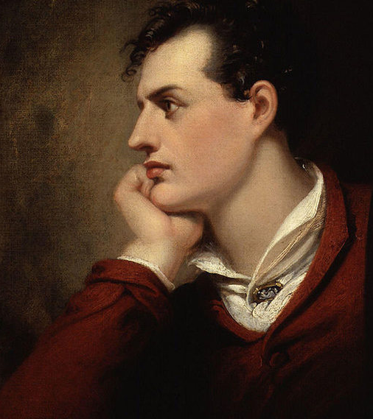
Starter
Define each of the words in the lesson title
Notes:
Ensure that the students understand the different terms, particularly ‘bigot’.
Image of Lord Byron from the National Portrait Gallery, London, image in the public domain. His quote is where the lesson gets its title (see exit question on final slide).

Slide 3
Defining reason
‘The ability of a healthy mind to think and make judgments, especially based on practical facts and valid evidence’
(from the Cambridge English dictionary)
Write down the definition
Based on this definition, which areas of knowledge do you think most rely on our ability to ‘reason’?

Slide 4
Terms to understand by the end of the lesson
Induction
Deduction
Syllogism
Logical fallacies
During the lesson, focus on the points to consider.
Jot down your ideas to these points as we go along.
Notes:
This handout can be used by the students to record this information as you deliver the lesson.

Slide 5
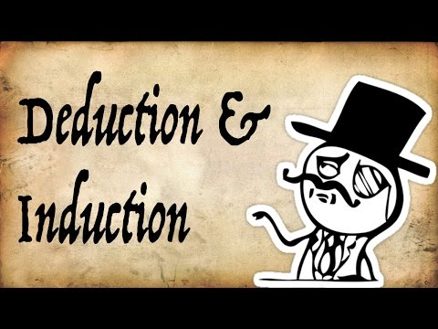
Types of reasoning: induction & deduction
Points to consider -
What’s the difference between deduction and induction?
Which one do people (you?) more commonly use?
Which one is produces more certain knowledge?
Notes:
Discuss students’ responses to the video.
Add the terms ‘going from the general to the specific’ for deduction, and ‘going from the specific to the general’ for induction.
Link induction to generalizations and stereotyping. Are these always invalid? Can they help us to understand the world?

Slide 6
Types of reasoning: syllogisms
Points to consider:
A syllogism is a type of deduction, and when followed correctly, produces a certain conclusion:
Premise 1: All humans are mortal
Premise 2: Socrates is a human
Conclusion: Therefore, Socrates is mortal
But, if one of the premises is not certain, it leads to a flawed conclusion:
Premise 1: The IB Diploma requires you to work hard
Premise 2: Juan is an IB Diploma student
Conclusion: Juan works hard
Notes:
Animated slide.
Pause after the valid syllogism, and ask students to come up with other examples.
Try to make these as real as possible. Do the same after invalid syllogisms.
Jenga image illustrates the ‘building block’ nature of syllogisms - it stands up only when the pieces are placed in a valid way.

Slide 7
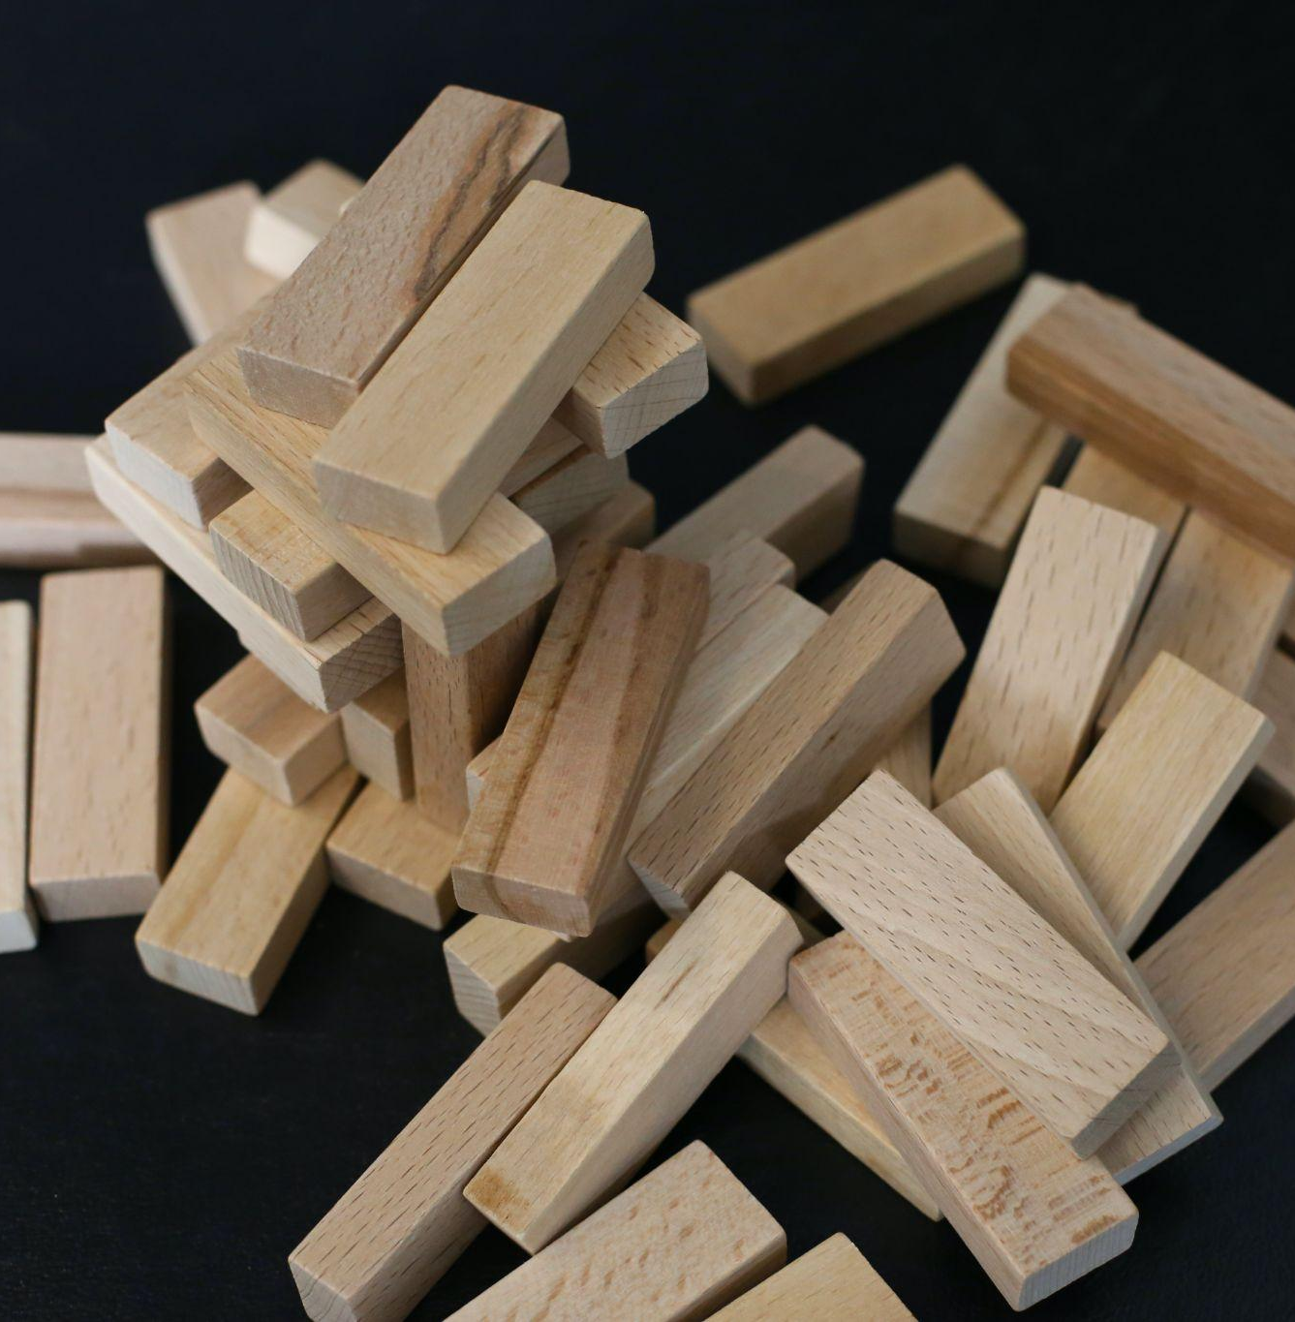
Flawed reasoning: logical fallacies
Points to consider:
What do you think a ‘logical fallacy’ is?
Follow the link to see examples of common ‘logical fallacies’
Which logical fallacy do you think is most commonly used, and why?
Which one do YOU use most?
Notes:
Link is here.
Get students to be honest about using fallacies.
Point out why it’s great to be aware of fallacies - you can pick anyone’s argument apart in seconds, you realize your own weaknesses when you apply reasoning, and overall, it helps us to avoid being misled and manipulated by other people.
Here is an article that helps understand the importance of being able to recognize logical fallacies.
See last slide for rationale behind the image.

Slide 8
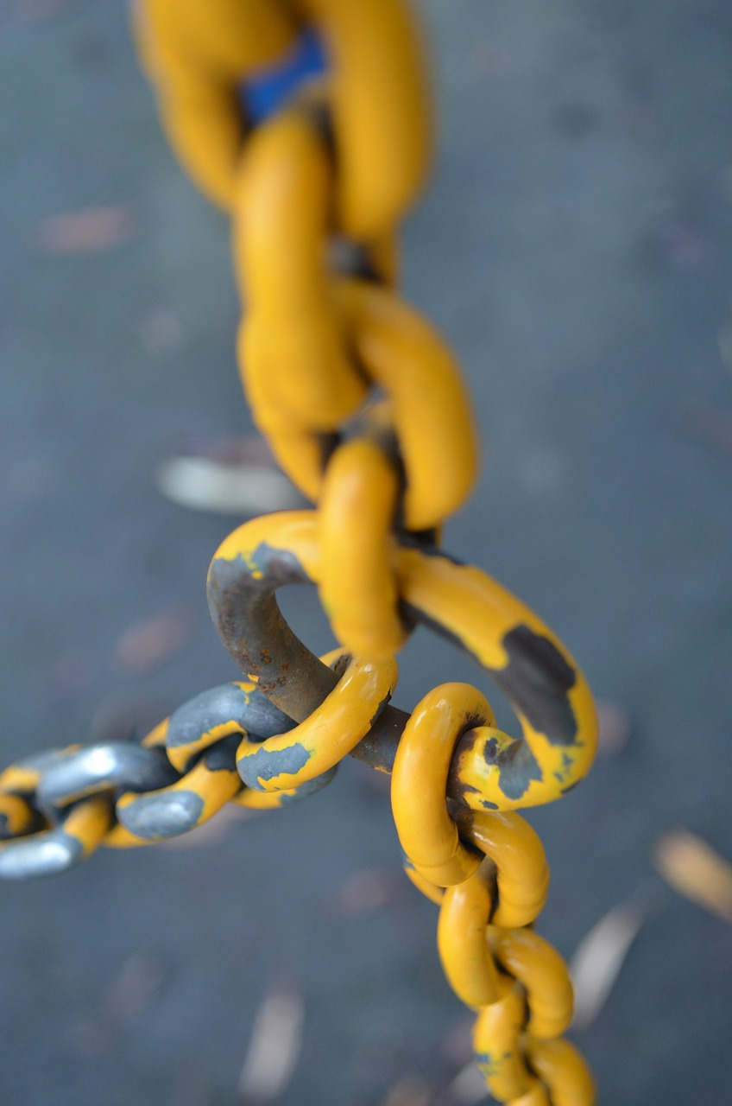
Pulling it all together
Match up your number with one of today’s concepts (below).
Fill in your row on the handout
Swap answers with other pairs to complete the document
Induction
Deduction
Valid syllogisms
Flawed syllogisms
Logical fallacies

Slide 9
Links to the TOK exhibition
Related exhibition prompt What counts as a good justification for a claim? (IAP-19)
Refer to the ideas from this lesson to answer this question.
For example, think about the importance of logic and reason in justifying the claims we make about the world.
Which objects could help to illustrate your answer?
Notes:
Optional slide, if you want to help students to take ownership of the IA prompts (IAPs) for the TOK exhibition

Slide 10
EXIT
Those who will not reason, are bigots; those who cannot, are fools; and those who dare not, are slaves. (George Gordon Byron)
Do you agree with Lord Byron? Have you ever been guilty of being any of these things?
Notes:
Might be worth linking back to the starter question, to ensure students understand what Byron meant
Here is the banner for the lesson (see image above) - post-its can be displayed around it
See the BQ6 assessment tracker for suggestions on providing feedback, and recording students’ progress.

Slide 11
Linking this lesson to the course
During this lesson, we consider the highlighted aspects of the TOK course
The images used in the presentation slides can also give students ideas about selecting exhibition objects; see also our link below to specific IA prompts
CORE THEME | OPTIONAL THEMES | AREAS OF KNOWLEDGE | TOK ASSESSMENT
Knowledge & the knower | Indigenous societies | The arts | The TOK essay
 | Language | History
 | Politics | The human sciences | The TOK exhibition Could be linked to IAP-4 (doubt), IAP-19 (justification), IAP-28 (objectivity)
 | Religion | Mathematics
 | Technology | The natural sciences

Slide 12
Explore the TOK themes and areas of knowledge in more depth via a range of thinkers, media sources, and other resources, in our EXPLORATION POINTS DOCUMENTS.
Access the documents via the links below. You’ll also find the EP icons on all of the TOK course pages of the site to help you unpack the quotes, KQs, and real-life situations that you find there.
CORE THEME
Knowledge & the knower
OPTIONAL THEMES
Indigenous societies
Language
Politics
Religion
Technology
AREAS OF KNOWLEDGE
The arts
History
Human sciences
Mathematics
Natural sciences
Notes:
Use this slide to access the ‘Exploration Points’ notes for BQ6, which will help students to develop a deeper knowledge of any TOK theme or area of knowledge. This will not only help them to master the TOK course in general, but also craft a great exhibition or essay.
Be ready to provide more guidance on how to use this resource - ie, which media sources to focus on, which questions to address, which TED talks to watch, and which key terms and ideas to understand.

